Slide 1
Book Recommendation System
Presented by: Guided by:
Arjun P 1RN20IS026 Akshay Chaskar
Kaushik Krishna 1RN20CS065 NASTECH

Slide 2
PROJECT OBJECTIVES
Have you ever wondered for a system which suggest a new set of books for your previously read books !?. Well Recommendation Systems are there to help, they are very common to us due to continuous demand and need to get the best book to read.
In this Project we analyse and preprocess the Book Recommendation Dataset collected by Cai-Nicolas Ziegler and apply Machine Learning to recommend different books from a book you previously read.

Slide 3
DATA DESCRIPTION
Users
Contains the users. Note that user IDs (User-ID) have been anonymized and map to integers. Demographic data is provided (Location, Age) if available. Otherwise, these fields contain NULL-values.
Books
Books are identified by their respective ISBN. Invalid ISBNs have already been removed from the dataset. Moreover, some content-based information is given (Book-Title, Book-Author, Year-Of-Publication, Publisher), obtained from Amazon Web Services. Note that in case of several authors, only the first is provided. URLs linking to cover images are also given, appearing in three different flavours (Image-URL-S, Image-URL-M, Image-URL-L), i.e., small, medium, large. These URLs point to the Amazon web site.
Ratings
Contains the book rating information. Ratings (Book-Rating) are either explicit, expressed on a scale from 1-10 (higher values denoting higher appreciation), or implicit, expressed by 0.

Slide 4
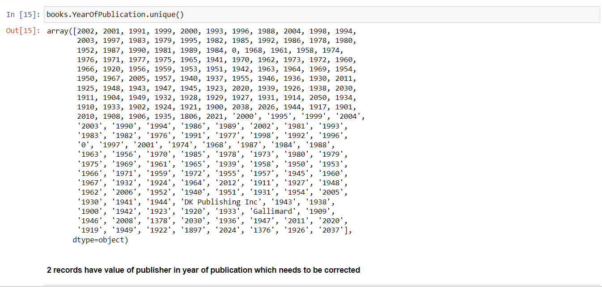
DATA PREPROCESSING
The Books dataset is being scanned for any abnormality

Slide 5
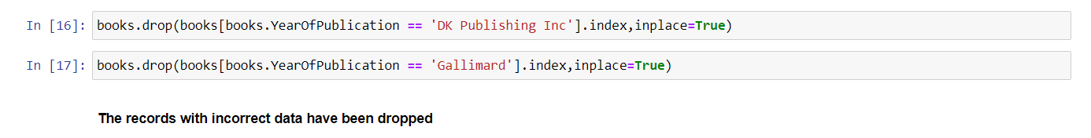
The previously observed abnormalities are handled as follows

Slide 6
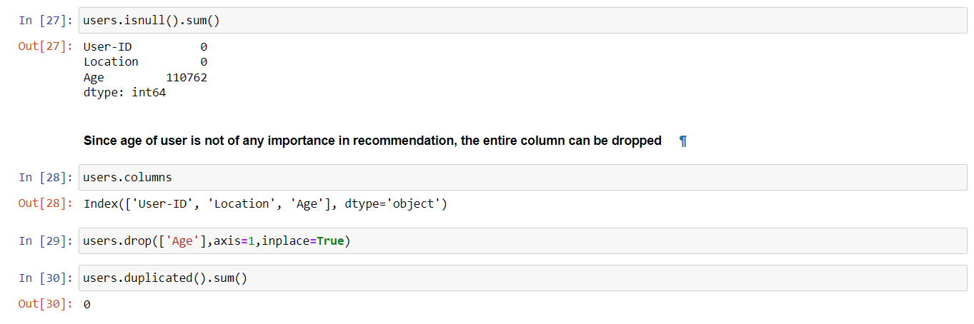
Data Cleaning
Data cleaning is performed on Users dataset is performed by handling the null values present in it

Slide 7
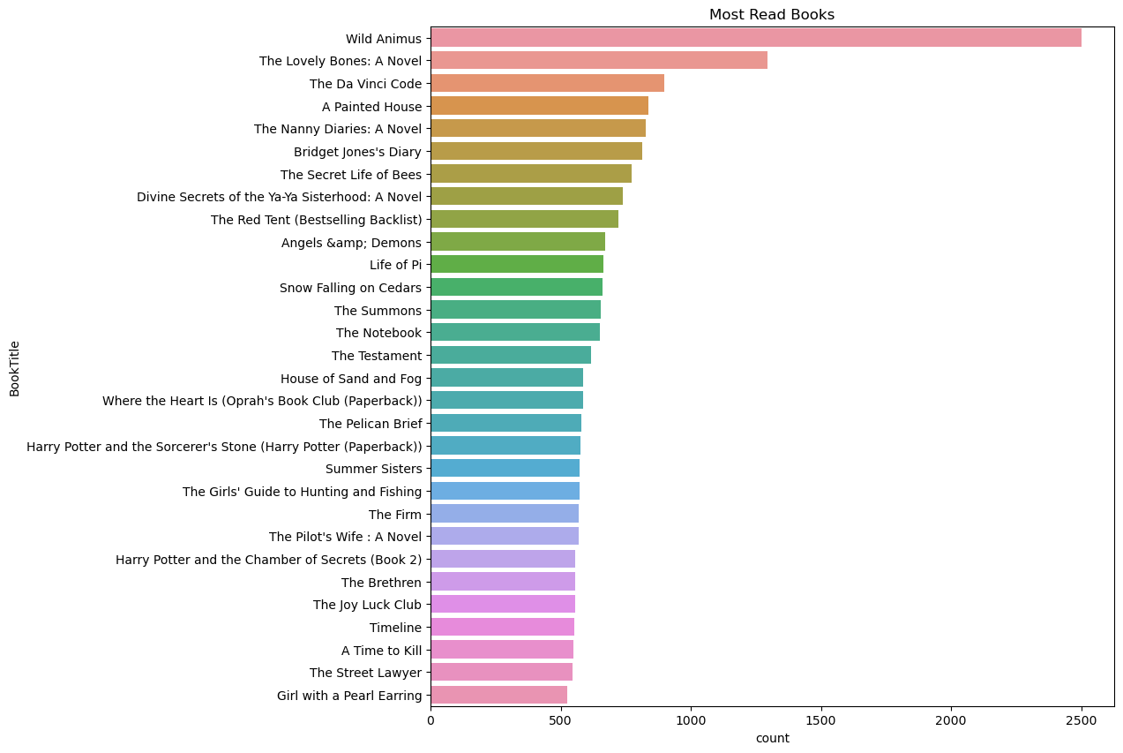
Visualising top 30 most read books
Using Series.value_counts() and sns.barplotfor creating data and visualisation respectively. We can obesrve that Wild Animus has the most read books by a huge margin followed by The Lovely Bones

Slide 8
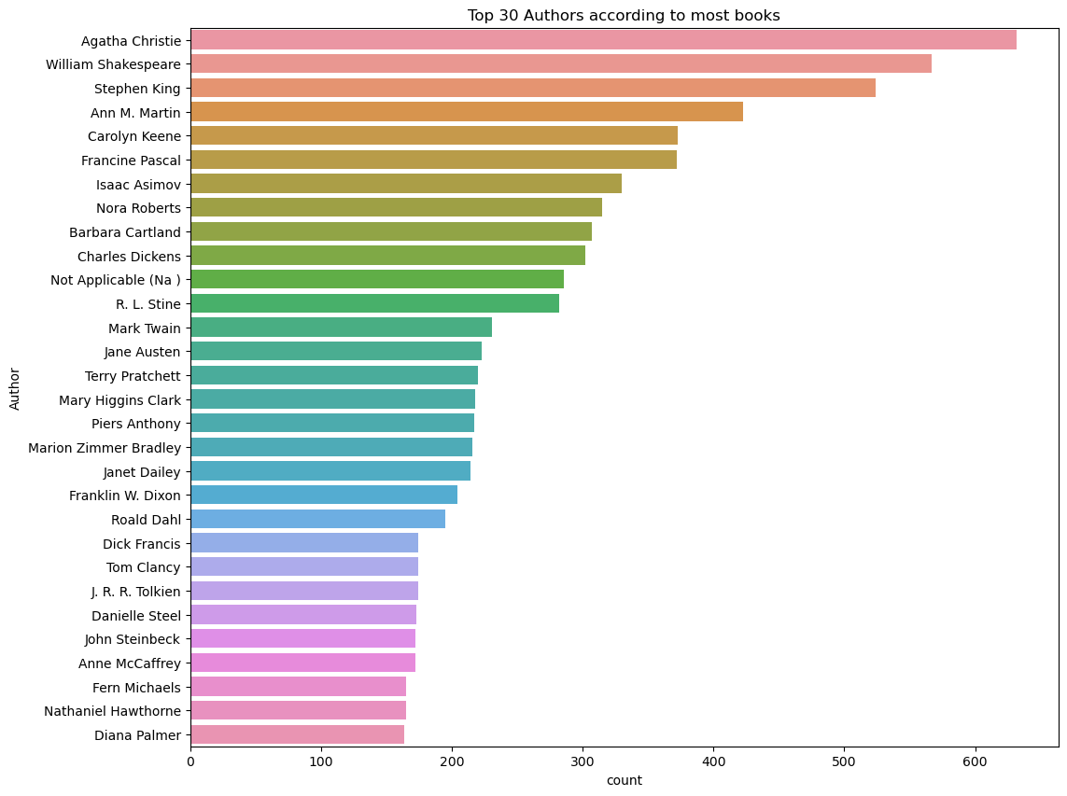
Visualising top 30 authors with most books

Slide 9
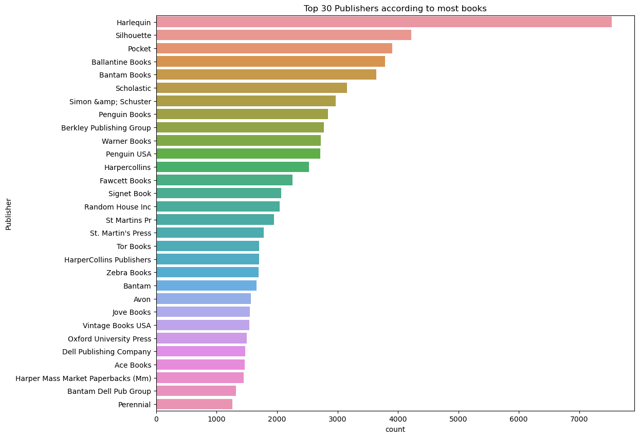
Visualising top 30 publishers with most books

Slide 10
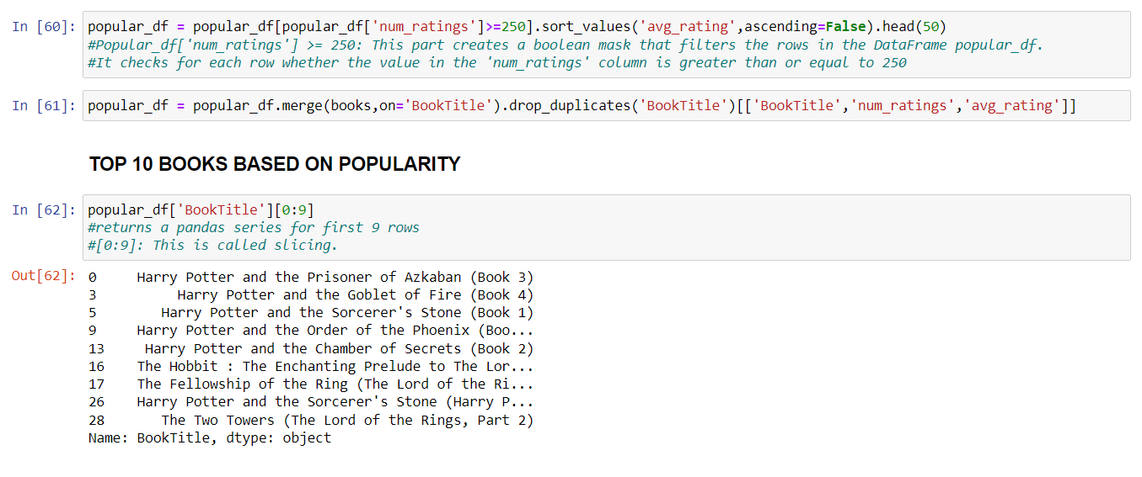
Popularity Based Recommender System

Slide 11
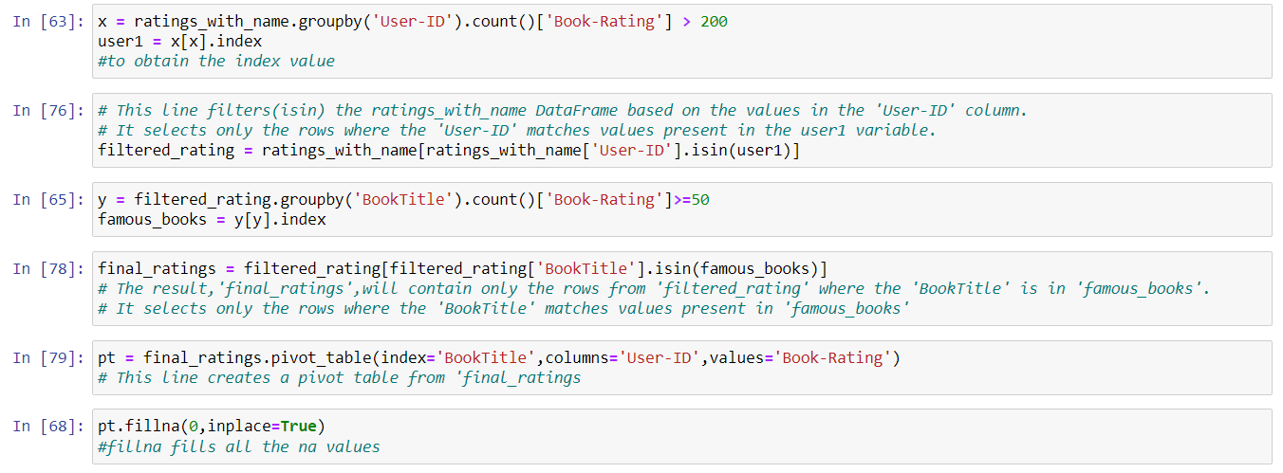
Collaborative Filtering Based Recommender System
Pivot table creation(pt)

Slide 12
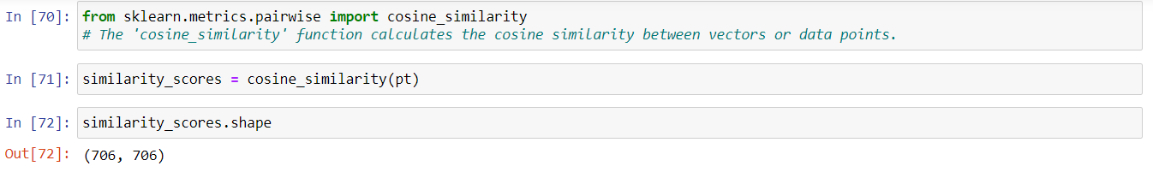
Finding the cosine similarity between data points

Slide 13
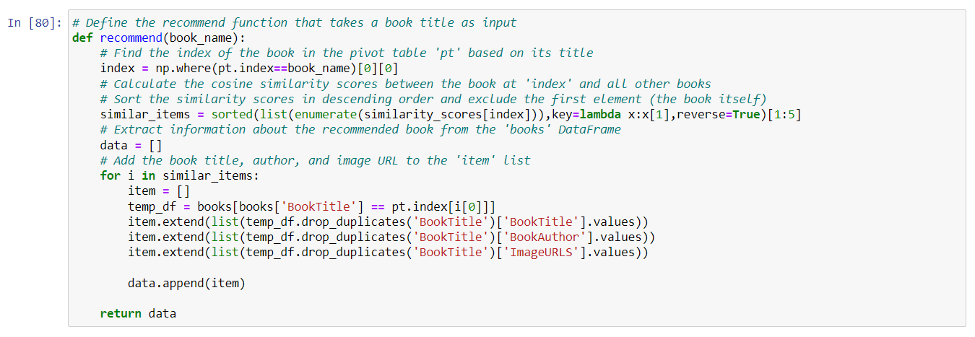
Defining the recommend function

Slide 14
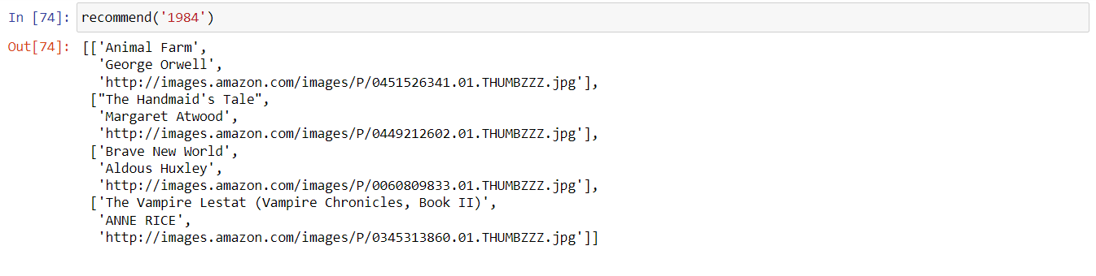
Output

Slide 15
Thank You !

